Slide 1

PVT Manager Test Leader Training

Slide 2

PVT – Performance Validation Test
Verify and Validate functionality in a truck from a driver perspective
Verify – the driver manual
Validate – with experienced drivers
Corresponds to many very demanding customers using ALL functionality in the complete vehicle

Slide 3
Test Structure Hierarchy
PVT
Truck Function Area
Truck Function Area
Truck Function Area
Truck Function Area
TestCase
Function
Function
Function
Function
TestCase
TestCase
TestCase
-Here is where the VehicleSpec meets functions!
-The VARIANT controls which components!
-Easy to understand
-”Stand alone”
- Component independent
Categorization
- Slightly connected to Commodities
11
170
1000

Slide 4

The Atomic PVT
Smallest piece in building a PVT is the test case!
From that we can generate statistics and results with several different views
Executing test cases is sequential testing and used for verification.
But it is actually what happens in between the testcases that is important when we are validating a product. For that, experience from the product usage is critical.

Slide 5
Testcases vs Functions and testcoverage
F#1
F#4
F#6
F#1
F#2
F#3
F#4
F#5
F#6
F#1
F#2
F#3
F#4
F#5
F#6
F#1
F#2
F#3
F#4
F#5
F#n
F#1
F#4
F#6
F#1
F#2
F#3
F#4
F#5
F#6
F#1
F#2
F#3
F#4
F#5
F#6
F#1
F#2
F#3
F#4
F#5
F#n
F#1
F#4
F#6
F#1
F#2
F#3
F#4
F#5
F#6
F#1
F#2
F#3
F#4
F#5
F#6
F#1
F#2
F#3
F#4
F#5
F#n
F#1
F#4
F#6
F#1
F#2
F#3
F#4
F#6
Road Conditions
Weather Conditions
Endurance
Regional
Country
External equipment
F#1
F#2
F#3
F#4
F#6
Test Depth
TC/Function
F#1
F#2
F#3
F#4
F#n
F#1
F#4
F#6
F#1
F#2
F#4
F#6
F#1
F#2
F#4
F#6
F#1
F#2
F#4
F#n
F#1
F#6
F#1
F#6
F#1
F#6
Test environment
F#1
F#n
Test Width
box
Functions
= One testcase for a Function

Slide 6
Formal Truck Function Verification & Validation PVT CHECK
One testcase/Available functions
Very high level testing
~8h/truck
Finds stoppers in all available functions
Used for delivery control
box
= One testcase for a Function

Slide 7
Formal Truck Function Verification & Validation PVT TOTAL
ALL testcases/Available functions
Dig deep!
~4weeks/truck
Exercise and challenge complete system
Most thorough Formal Verification
box
= One testcase for a Function

Slide 8
Formal Truck Function Verification & Validation PVT Base
HALF of all testcases/Available functions
Dig pretty deep!
~2weeks/truck
Exercise and challenge complete system
”Normal Use” Formal Verification
Missing from TOTAL is:
Measurements! (In Base we trust the system, eg. Fuel level)
Sleep over!
Timeconsuming testcases
Jeopardize the system
Parameter changes
Diagnostics
Jinx the system
box
= One testcase for a Function

Slide 9
Truck Function Validation PVT Europe
Most used functions during normal use are tested in several different environments. ~6weeks/truck
Environmental factor:
Countries
Road conditions
Traffic situations (Ferries, tunnels, traffic jams etc.)
Climate changes
Sleepover at truck stops
Using experiences from drivers
Validation test when product is mature enough
box
= One testcase for a Function

Slide 10
Truck Function Validation PVT Haulage
SOME functions with several testcases are tested in different environments on a high level.
~6weeks/truck
Requirement on mileage.
Environmental factor:
mileage
Validation test when product is mature enough.
box
= One testcase for a Function

Slide 11
Truck Function Verification & Validation PVT Development
Custom Built test
Any test that the TestRequester orders
Using a PVT Check for regression testing
Normally used early in projects to evaluate a single project in a truck
box
= One testcase for a Function

Slide 12
Vehicle Spec for a certain test PVT TOTAL
Function not available
Adding Vehicle Spec to a test will remove Functions and Testcases from the test.
Function coverage
Testcase coverage .
= Test Coverage (Relative Variant coverage)
box
Testcase not available
= One testcase for a Function
12
2013-03-06

Slide 13
Project activities
Function and maturity growth
Development
Validation
Verification
PVT Development
PVT Check
PVT activities
PVT Base
PVT Total
PVT Total
Chain of rising PVT
PVT Dev: only development
PVT Check: First formal verification
PVT BASE/TOTAL: Heavy Verification
PVT HAUL: Verification and Validation
PVT EU: Only Validation
PVT Haul
PVT EU
PVT EU
Heavy formal verification,
Many trucks,
High spec
PVT City
First formal verification with a few trucks, low spec
Support project development with high project focused tests
PVT Cons
Validation!

Slide 14
Foundations of PVT
TR
Test Request – The Customer and a desire
Test Engineer that can transform a request to a test
A test engineer is the interface between; the projects, the vehicle, the drivers, the logging equipment, the desire, the reports and the result.
Tools that supports all logging needed to generate a good result
A tool suite that supports all needs in executing all kinds of different tests.
Test system that supports both flexible and structured testing
A Test Structure Hierarchy that generates statistics and support conclusions without loosing the creativity to test.
Experienced Drivers -
Dedicated and devoted to their job
The foundation of product validation! People who knows how to use the product

Slide 15
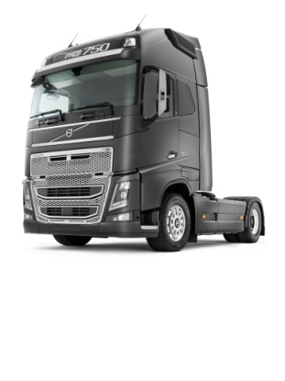

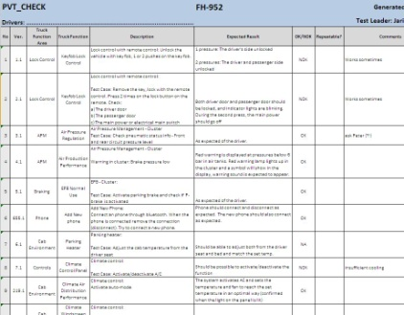
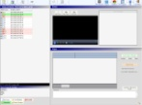



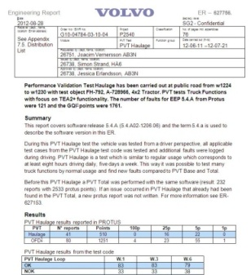
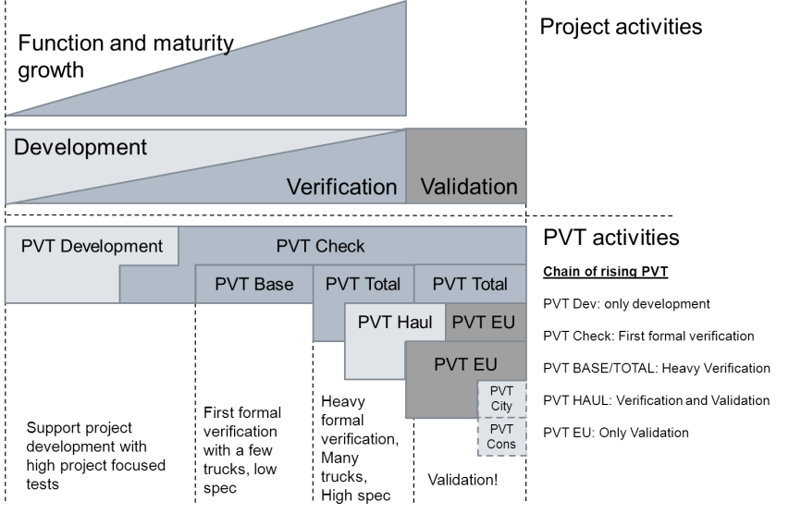
Truck Function Validation (PVT - Performance Validation Test)
Development of E-FACTS
Data Refiner App.
PVT Test Code
Local Data Collector Raw Data
(Not for PVT Check)
In vehicle
logger
New SW Loop
Protus
Verification
ER-Report
Truck Function
Status
Verification test of driver manual &
Validation test of software functionality from a driver perspective

Slide 16
Lessons Learned from site Lyon
Presented by Julien Rouge Lyon TFV Manager

Slide 17
Lessons learned from Lyon
Networking is crucial, securing understanding & acceptance by:
Direct contacts within the fault resolution process (local specific processes e.g. ”PATI”)
Testing organizations (RT/AET/FT)
Engineering
Project people (FVV-PMO, Product PM…)
Features ==> ”FVV one voice”
Brands
Renault adaptation of the test cases was the biggest work
E-FACTS was quite well prepared for Lyon usage

Slide 18
Lessons learned from Lyon
Aim for the fastest possible team set-up:
Work the right way from the start, don’t cope too much
Look for a PVT Tester from the start (difficult to find, long to educate)
Drivers training:
Educate drivers in truck functionality & technology (Bluetooth phones…)
Then proceed to PVT testing
Synch work with GOT for speed & support (weekly in the beginning…)

Slide 19
Lessons learned from Lyon
Recruitment process issues:
It takes a long time to find the right people
Internal transfer can take a long time (6 months for TE)
The company economic status influences recruitment a lot
Implementation financing:
A PIM project is not so bad, yet a lot of Presentations to prepare, requiring help from a experienced PM
P2683 also participated a lot to the cost
IT data transfer rate from proving ground can be an issue

Slide 20
Plan to implement PVT at other sites
Presented by Martin Svennungsson

Slide 21
PVT at other site
BF59990 TFV
HPG & Lundby
BF59991 TFV
LVPG & St Priest
Truck Function Specialist
Global TFV Coordinator
GSO
PVT Planning Responsible
CUR
PVT
Performance Validation Test
PVT Trouble Shooter
SW Offer & Telematics
Responsible
E-FACTS Applications &
Tools
PVT
Test Engineer
PVT
Tester
PVT
Developer
TFV System Architect
PVT
Drivers
TFV Applications and Tools Local Super User
From Driver Team

Slide 22
PVT ramping phases - Overview
Draft
Learning routines
Networking
Visits
Project Sync
Infrastructure - IT - Testtracks - Equipment
Planning
Recruitment
Learning Truck Functions
Learning testcases
Developing testcases
Learning Brand culture
Evaluate cultural differences
Testrun on PVT Total
First real PVT for needed projects
Evaluate learning and execution
White book
Adapt
Document
Implementation Phase
Operational
Start-up phase
Learning phase
Execution phase
Evaluation phase

Slide 23

PVT ramping phases - Gates
Draft
Decided by Continental Manager PVT/ Global TFV Coordinator /Truck Function Specialist
Timeplan
Budget
Infrastructure
Roles
Resurces
Testtracks
Handshakes
Visit PVT Total in GOT
All roles have education and know what is expected from them
Test code OK status
Are every TC understood and have a result
Are we mature enough?
Implementation Phase
Operational
Start-up phase
Learning phase
Execution phase
Evaluation phase

Slide 24
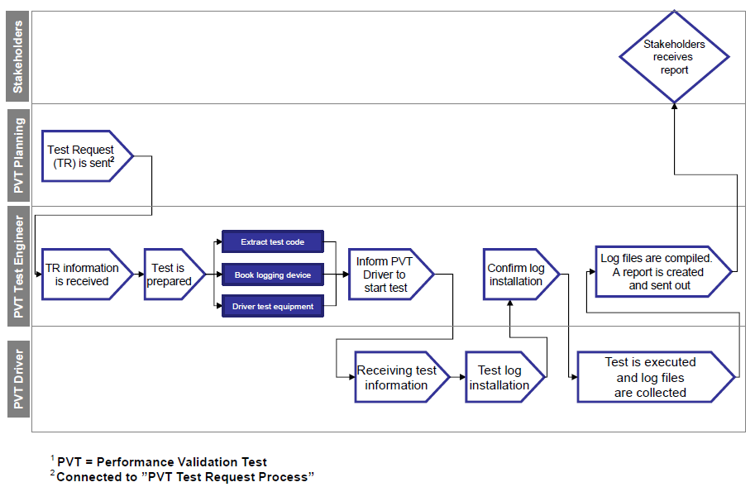
PVT Test Proces

Slide 25
PVT Manager - Purpose
Database for all Test Cases
Database for Test Sequences
Tool to generate Reports
Tool for Vehicle Planning
Adminitration tool for users and content
All questions – Send mail to ”Application E-FACTS”

Slide 26
PVT Manager Access Level
 | Test Leader | SE | ME | Tools | Adm
PVT Test Case Editor | View, CR, New | View, CR, New | Full |  | Full
TFA/TF | View | View | Full |  | Full
Test Sequence | View, Export | View, Export | Full |  | Full
Vehicle Planner | View | View | Full |  | Full
Vehicle Specification | View | View | Full
Reports |  |  |  |  | Full
Tool Box |  |  |  | x | Full

Slide 27
PVT Test Case Editor
Truck Function Area vs. Truck Functions vs. Test Case
Test case content – Product Class/Specification/Test method
Change Request or New test Case
Excel Printout
Filter and search for TC
SPEC ! = NOT, I = OR, && = AND
ProductClass $ = AND

Slide 28
Send a Test Case Request

Slide 29
PVT Test Sequences
Different PVT Test Methods
Typical Test Routine for the PVT Test Methods
Default Test Sequences
Custimized Test Sequences
Export Test Sequences
Test Leader Feedback to Site/Master Editor about problems found

Slide 30
Truck Function List Editor
Handles all Truck Functions and Trucks Function Areas
Gives short information about the Truck Functions
(Some mismatch in PROTUS, due to delay)

Slide 31
Reports
Only valid PVT trucks/SW are in the list
Ordered by mail to ”Support E-FACTS”
Individual Truck Report
Total Truck Function Report (need to be handled in Refiner first)
E2E Function Report
Compare SW package
Truck Function Consistency
Test Case Consistency
Currect Test Coverage

Slide 32
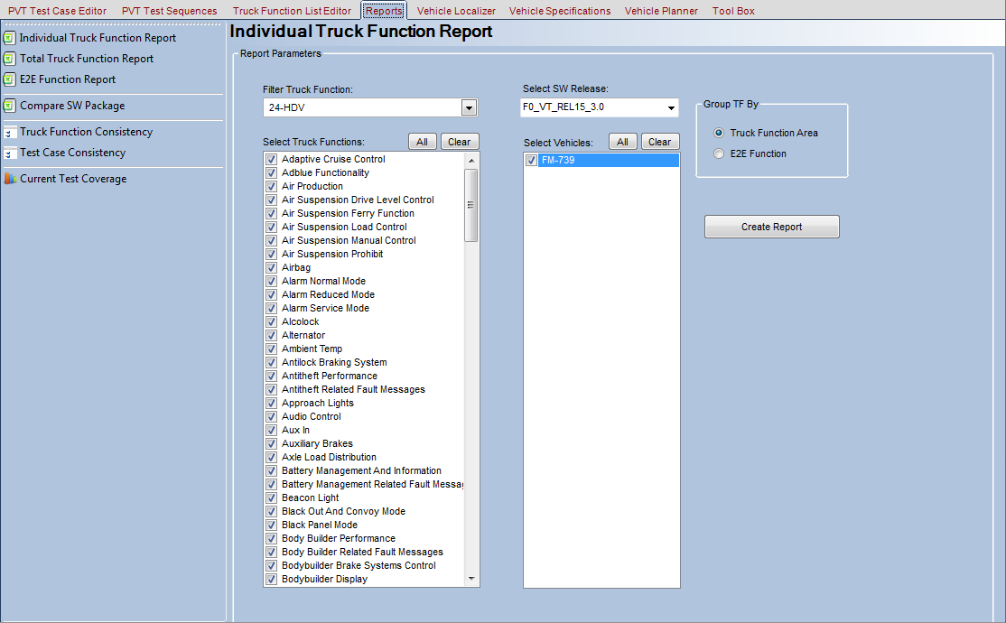
Reports

Slide 33
Reports – Individual Report

Slide 34
Vehicle Localizer
Showed the position for the last uploaded GPS data
Today PAUSED, due to future RDM possibilities

Slide 35
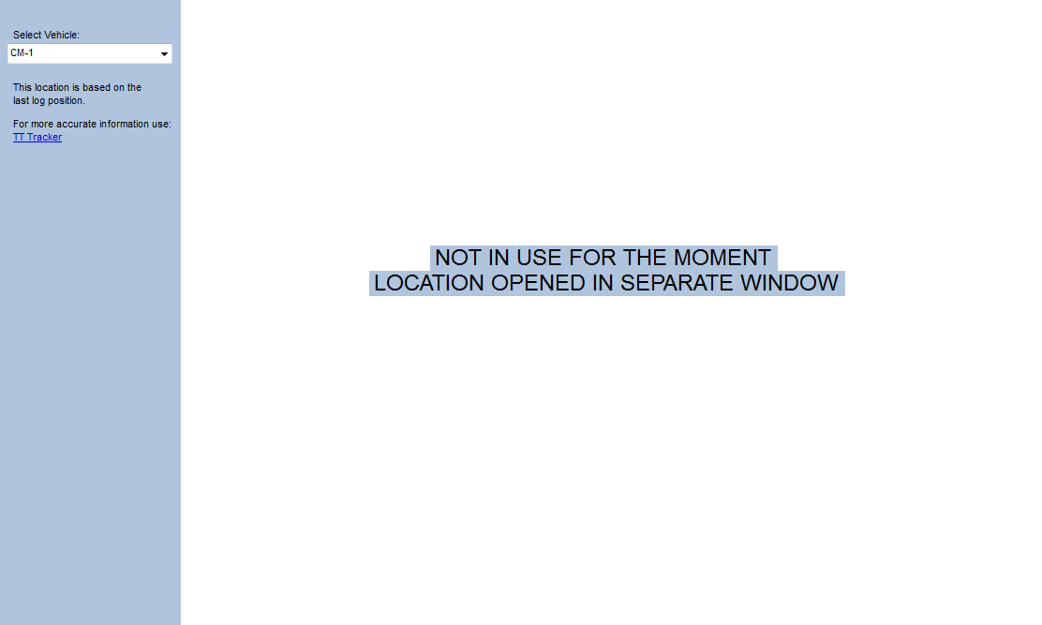
Vehicle Localizer

Slide 36
Vehicle Specification
Search and show Specification inside eFACTS
Should be updated once a month from PROTUS, total file
Should be updated every day from PROTUS for changes

Slide 37
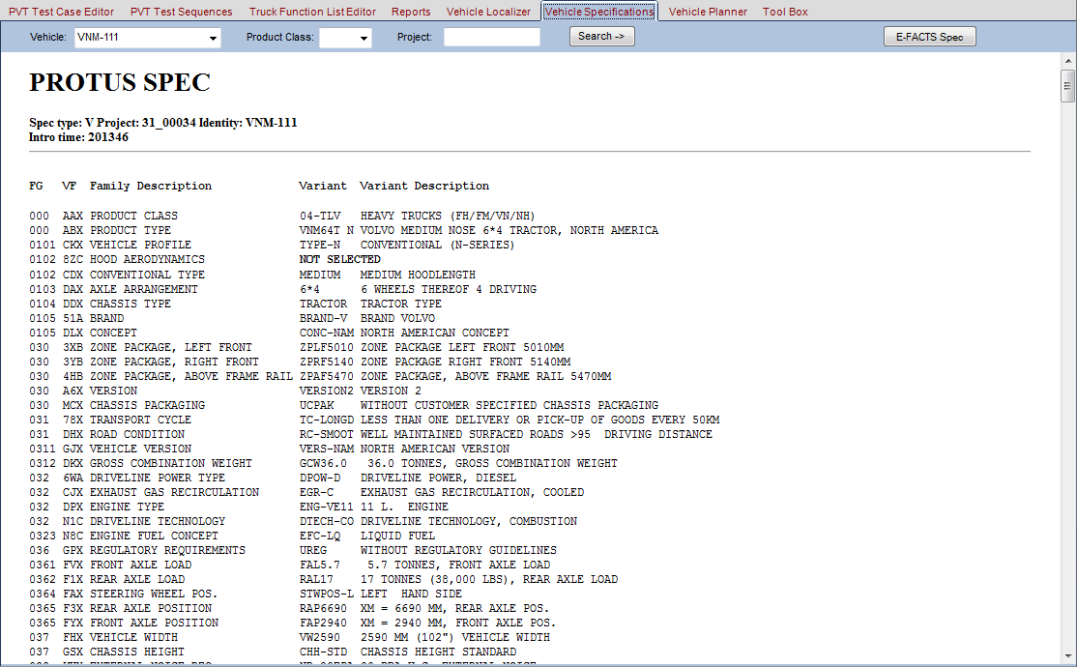
Vehicle Specification

Slide 38
Vehicle Planner
Tool to support Project to select trucks
Can also be used to check
Test Case Coverage
Test Function Coverage - Test Depth
Test Confidence

Slide 39
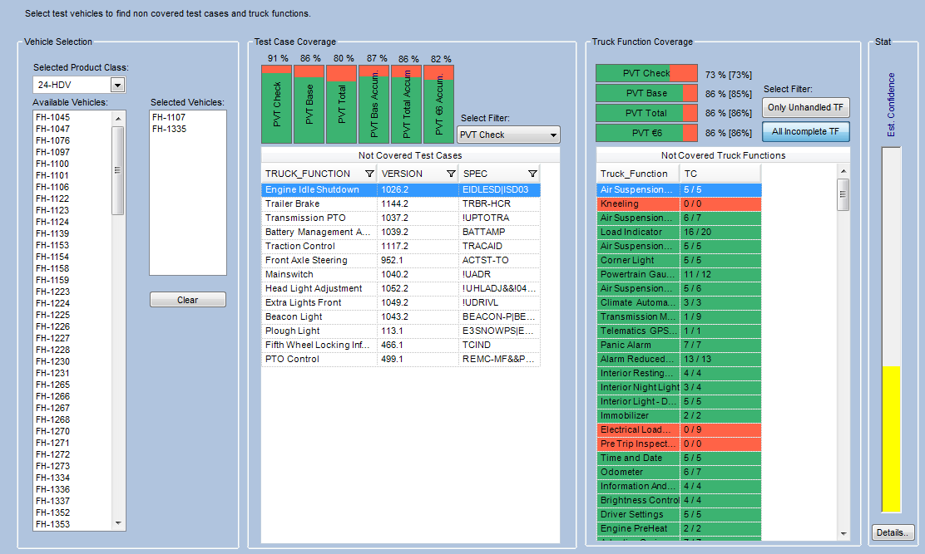
Vehicle Planner

Slide 40
Tool Box
Administration of
Move data to correct truck
Import Vehicle Specification from PROTUS
System Parameters
Users
SW versions
Status report PVT items (Vehicle/SW)
Mail contact
Measurement Topics

Slide 41
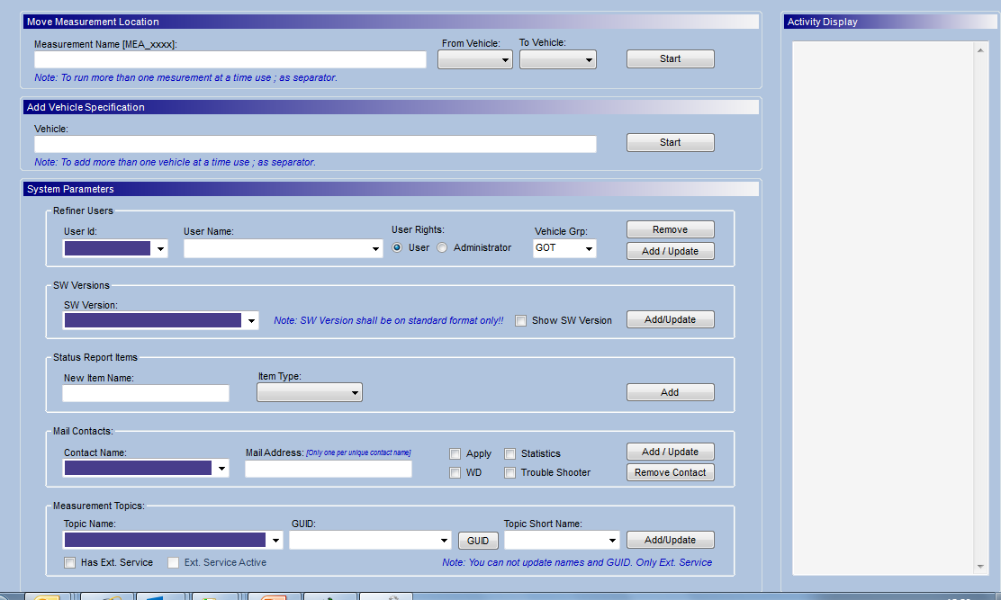
Tool Box - GUI

Slide 42
Refiner usage for PVT
Test Leader access level needed to handle results from PVT Testing.
Truck Function Status Report
Report fault against Test Cases

Slide 43
Job list (for Site and Master Editor)

Slide 44
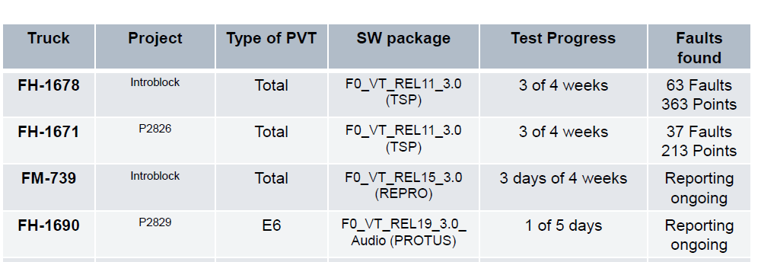
Weekly TFV Status Report – Delivered by GOT today
Example

